Slide 1
Breast Cancer Analysis
Babatunji Omoniwa

Slide 2
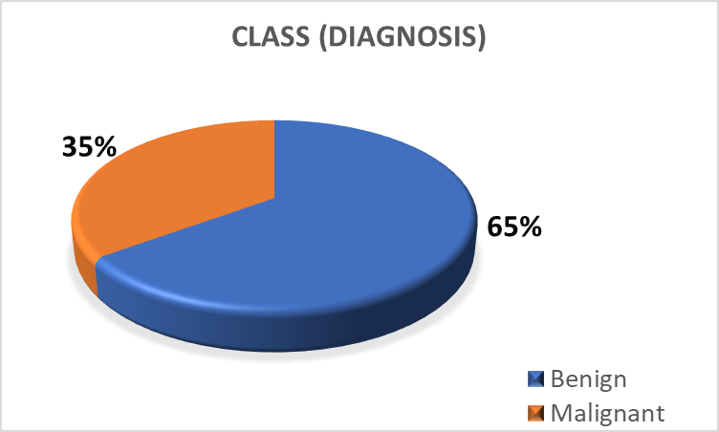
Current Trend based on findings

Slide 3
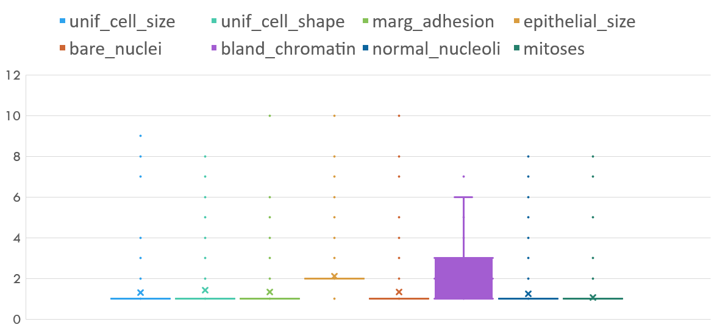
Measurements resulting to belign

Slide 4
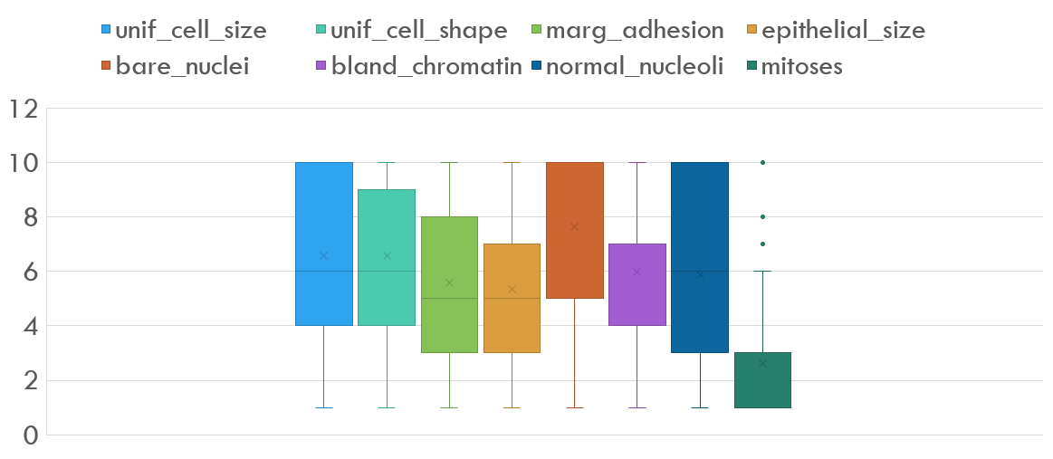
Measurements resulting to Malignant

Slide 5
Median of Measurements and trends

Slide 6
Mean of Measurements and trends

Slide 7
remark
About 65% are belign, while 35% are malignant.
From the data measurements made available, we observe that all measurements except the mitosis distinguishes belign or malignant cases.

